Slide 1
Biblio
Dan Crankshaw
Cain Lu
Paul O’Neill
Jiefeng Zhai

Slide 2
Agenda
Overview
Architecture
Design
Use Cases
Implementation Status

Slide 3
Motivation
Strange File Names
Music libraries, so why not text-based libraries?
Non-hierarchical relationships
Organize and view in one application
Notes:
Can also say something about how this would specifically be helpful for academic papers (i.e. grad students and professors), as well as for anyone who has ever had to do a research paper using
Jstore or similar.
Also, some of the design motivation was to make it minimalistic and as easy to use as possible. In some cases, we are willing to sacrifice complex functionality for ease of use.

Slide 4
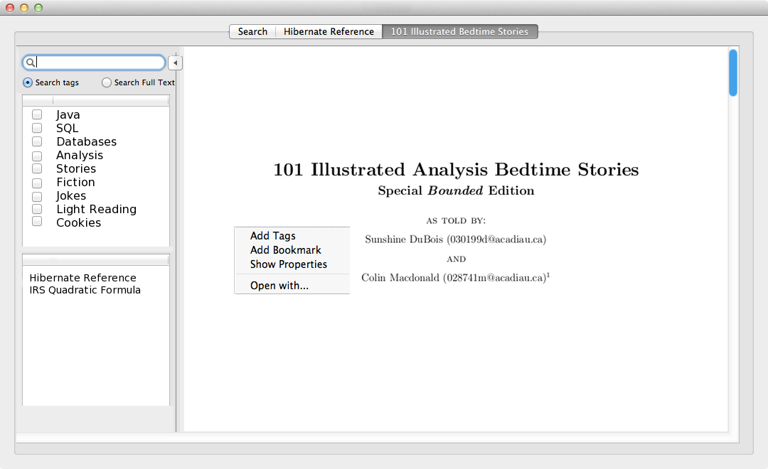
Reading

Slide 5
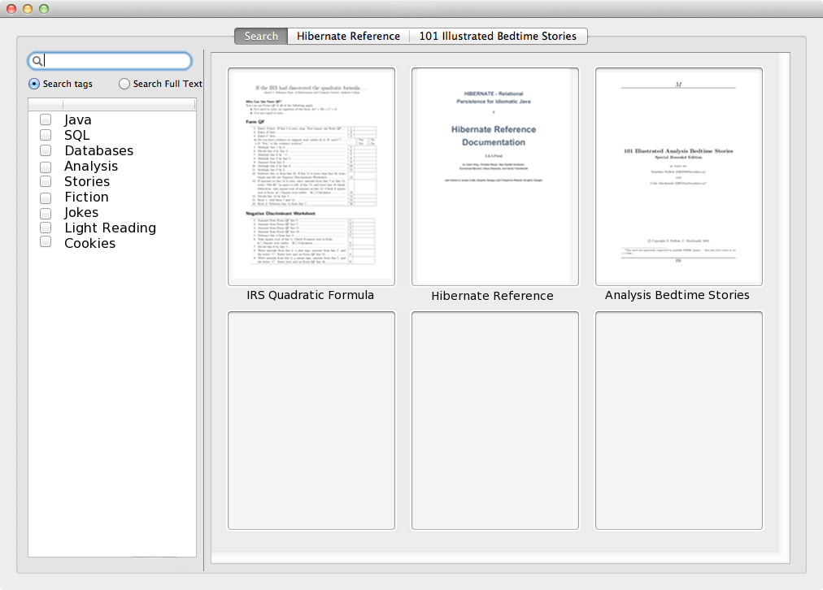
Searching

Slide 6
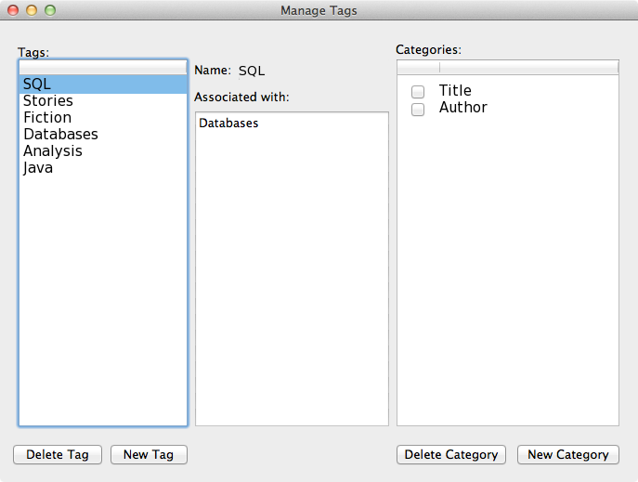
Tag Management

Slide 7
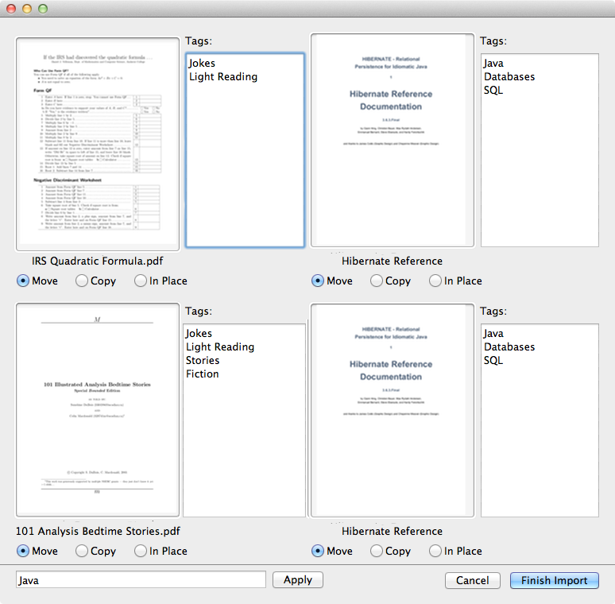
Importing

Slide 8
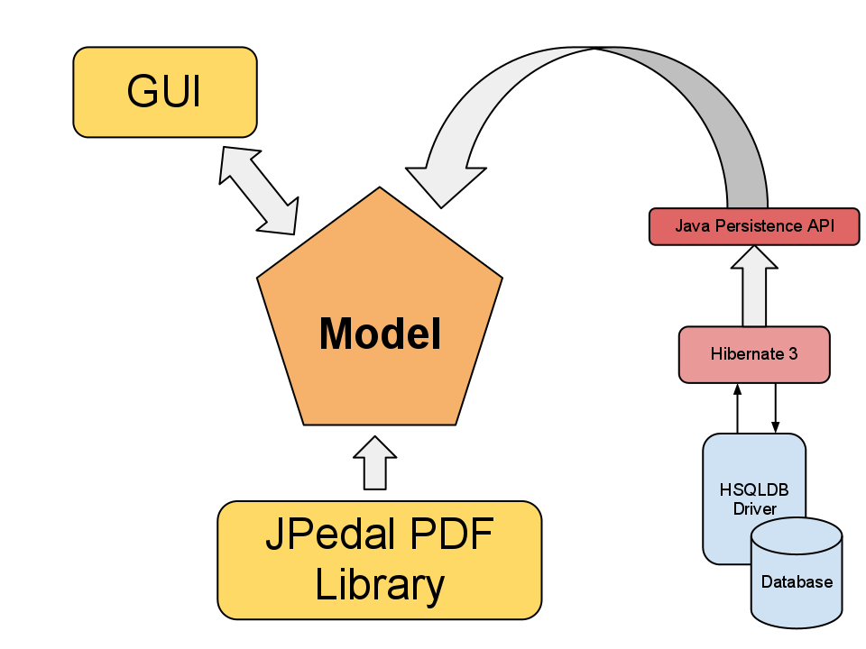
Architecture

Slide 9
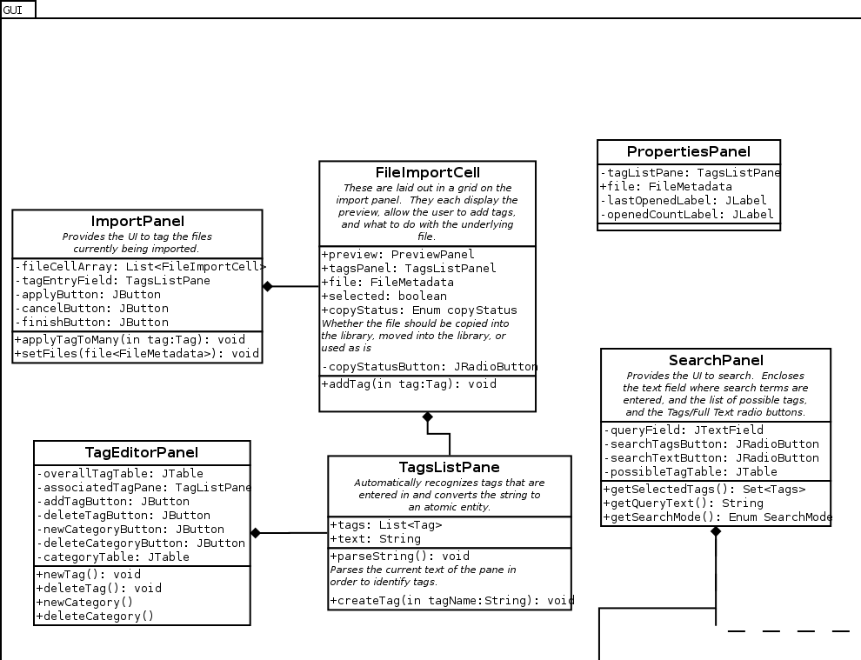
Code Overview: Import

Slide 10
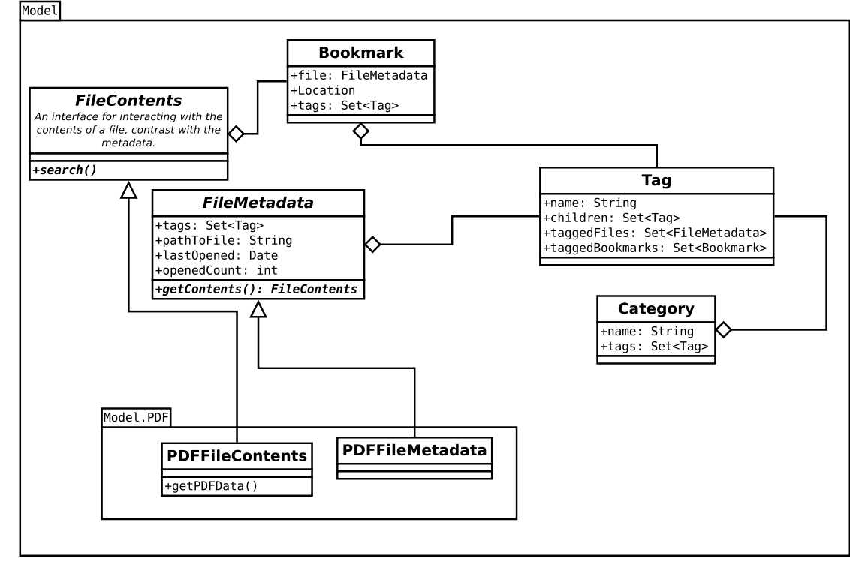
Code Overview: Model

Slide 11
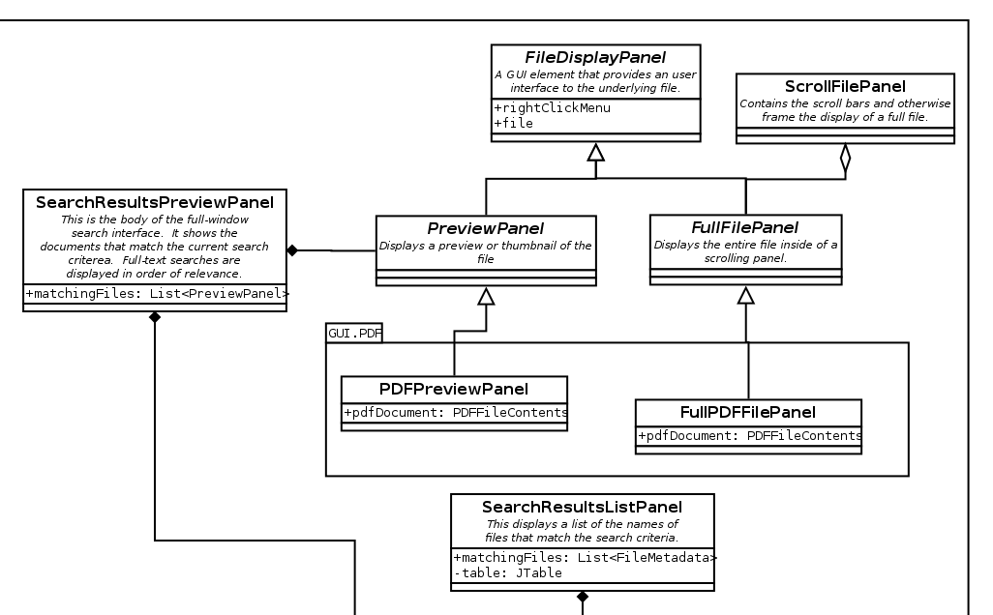
Code Overview: File Display

Slide 12
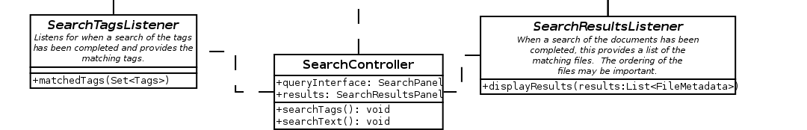
Code Overview: Search

Slide 13
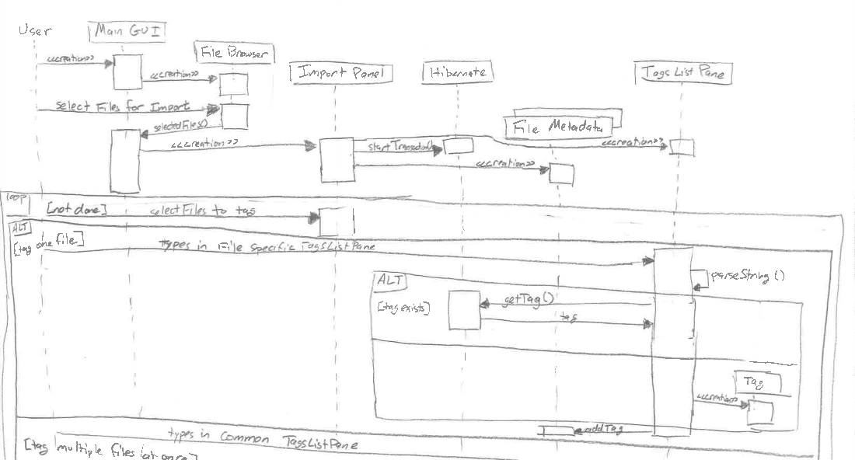
Use Cases

Slide 14
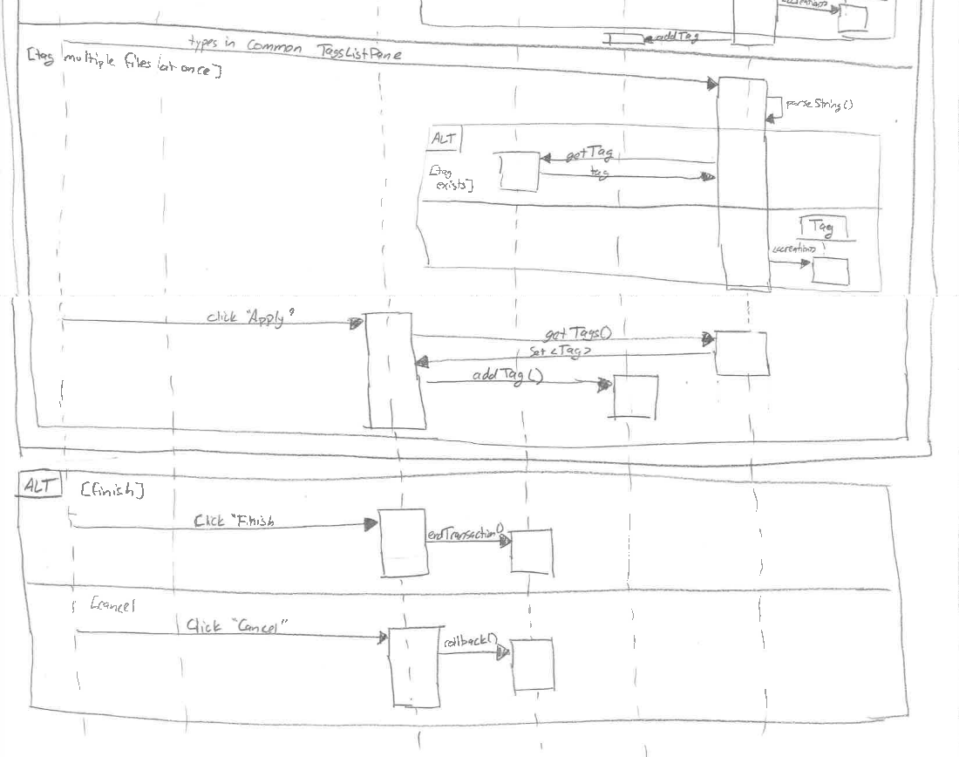
Use Cases

Slide 15
Importing

Slide 16
Status
Hibernate integrated with HSQLDB
Render and display PDFs in a scrollpane using JPedal
Basic import GUI

Slide 17
Plans
RSS Reader
Full-Text Search
More File Formats
Bookmarking
Notes:
Say something about some of the difficulties of full-text searching PDFs. They are stored as a tree, basically with a pointer to each letter. So just traversing text is much more complicated than iterating through a linear data structure

